Slide 1
ULTIMA 2.0
Josh Carter, Jordan Winkler, Kyle lucas

Slide 2
ULTIMA 2.0: Abstract
ULTIMA 2.0 is a simulated cooperative multitasking operating system. Over the course of development, the goal is to complete each component and develop a fully functional multi-tasking environment. This will be completed in four phases.

Slide 3
Phases of the ULTIMA 2.0 Operating System
Phase I: Scheduler & Semaphore
Phase II: Message Passing
Phase III: Memory Management
Phase IV: File System

Slide 4
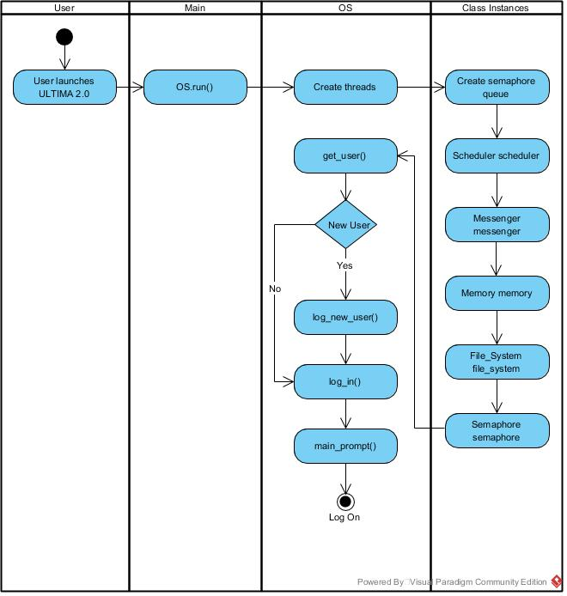
Diagrams
Logging into ULTIma 2.0
When a user executes the ULTIMA 2.0 operating system, main immediately calls OS.run().
The OS class handles all of the delegation of the operating system. It begins by creating some threads and then it has to create a queue to hold the semaphores.
Next, the OS class will create a scheduler, messenger, memory, file_system, and semaphore objects.
Once these have been successfully created, the OS class asks the user to log onto the system. If the user is already a registered user, the system will allow them to log into the OS, and log on will be complete. Otherwise, the user will have to create a profile before the system will allow them to log on.
Once the user has logged into the system, they are presented with a UI.

Slide 5
Phase I: Scheduler & Semaphore
Phase Goals
Our goal in Phase I is to implement the notion of a binary semaphore. We must be able to support any number of semaphores. This is critical, since future phases of this project introduce new resources which will certainly need synchronization.
In addition to this, Phase I also needs a scheduler with its own process table, or thread table, which should be implemented dynamically.

Slide 6
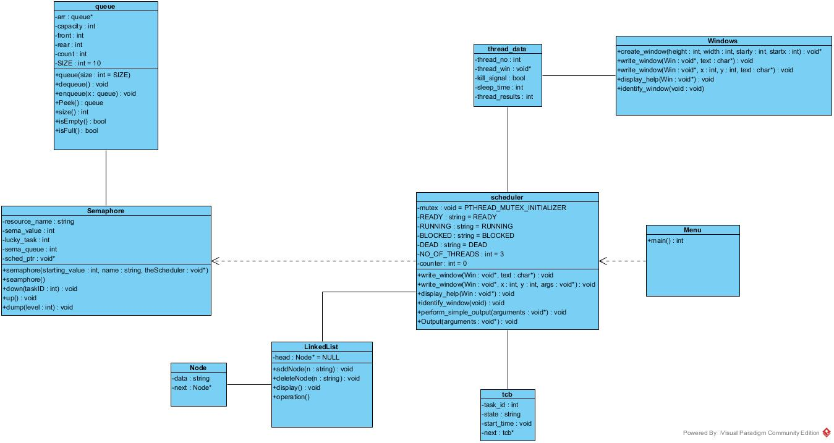
ULTIMA 2.0 Phase I Overview (Original design, OS class is missing)

Slide 7
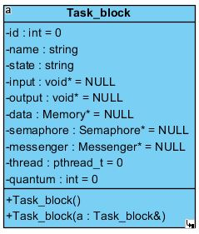
Class Task_block
The Task_block is the class which stores the data associated with each thread. Once a new task block is created it is pushed onto a queue of task blocks.
The Task_block is implemented dynamically so it can grow and shrink as needed.

Slide 8
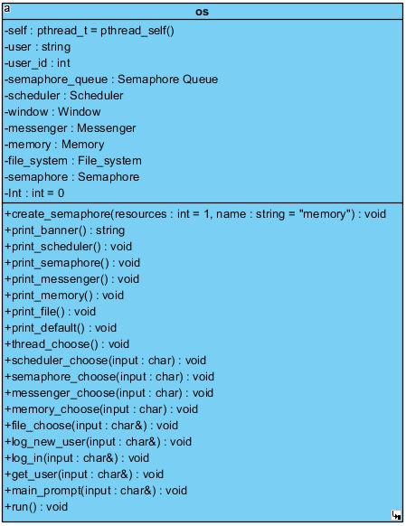
Class OS
The OS class is the main class for ULTIMA 2.0, and is the only class interacted with by main.
The OS class acts as a direct access to the different classes within the operating system. It uses object references from classes to make function calls from said classes.

Slide 9
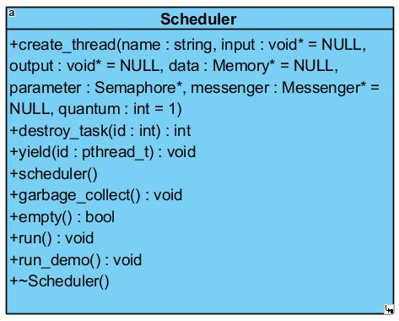
Class Scheduler
The Scheduler class is responsible for creating, scheduling, and running multithreaded processes.
In addition to this the scheduler will
Destroy tasks
Yield tasks
Collect garbage

Slide 10
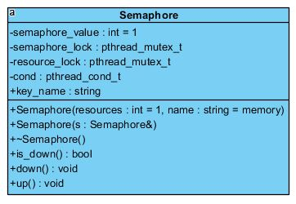
Class Semaphore
ULTIMA 2.0 will make use of a semaphore in the form of a mutex. The Semaphore class is the class which is responsible for creating and managing these semaphores.

Slide 11
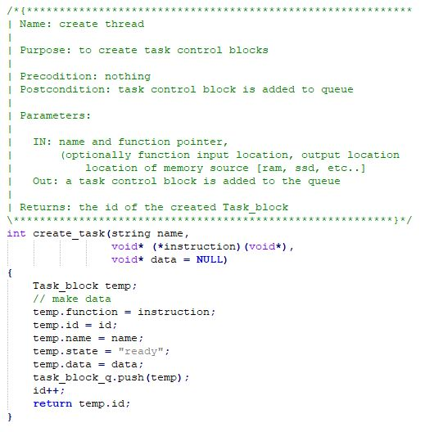
create_task()
When create_task() is called, the scheduler will create a Task_block with initialized values. The new task block is pushed onto the task block queue.
The state of the new task is set to “ready” so it will be selected to run by the scheduler.

Slide 12
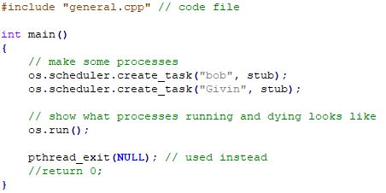
Creating a task: calling create_task()
Tasks are created in the first lines of main(). Since OS is the only class to interact with main(), the call needs to be placed through the OS class to the Scheduler class.

Slide 13
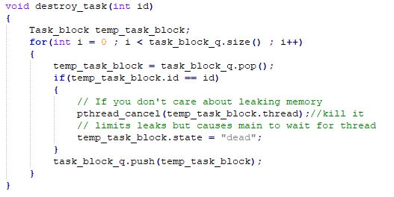
Destroying a task
Tasks are destroyed when destroy_task() is called and when they are, their status is set to “dead”.
A “dead” task is still part of the task queue and will be skipped by the scheduler when the task comes up for execution.

Slide 14
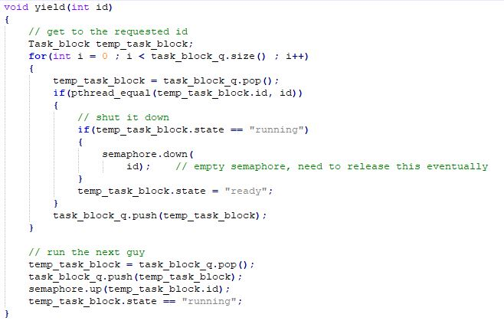
Yielding a task
When a task needs to be yielded, either because its quantum has been used up, or for some other purpose, yield() is called.

Slide 15
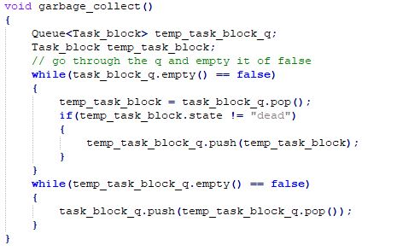
Collecting the dead
garbage_collect() is responsible for removing “dead” tasks from the scheduler queue.

Slide 16
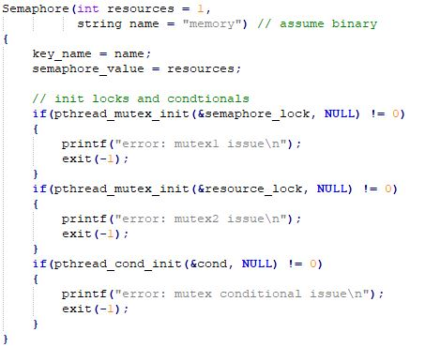
Creating a semaphore
Semaphores are created in the Semaphore class. Semaphore() is a standard constructor which creates a semaphore.

Slide 17
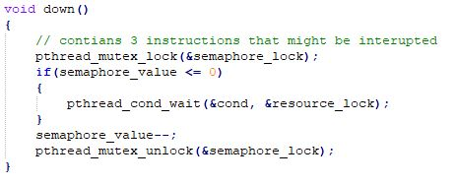
down()
A simple mutual exclusion, down() checks the value of the semaphore. If the value is not 1, the thread is yielded.

Slide 18
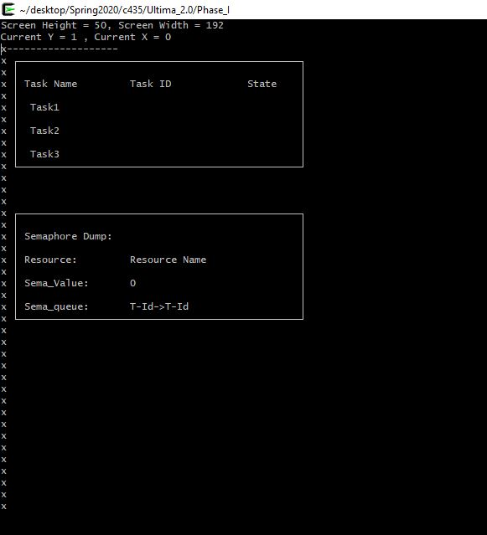
Phase I test

Slide 19
Phase II: Message Passing
Phase Goals
Design and implement message passing facilities into ULTIMA 2.0., allowing tasks to communicate with each other through the use of send() and receive() calls.

Slide 20
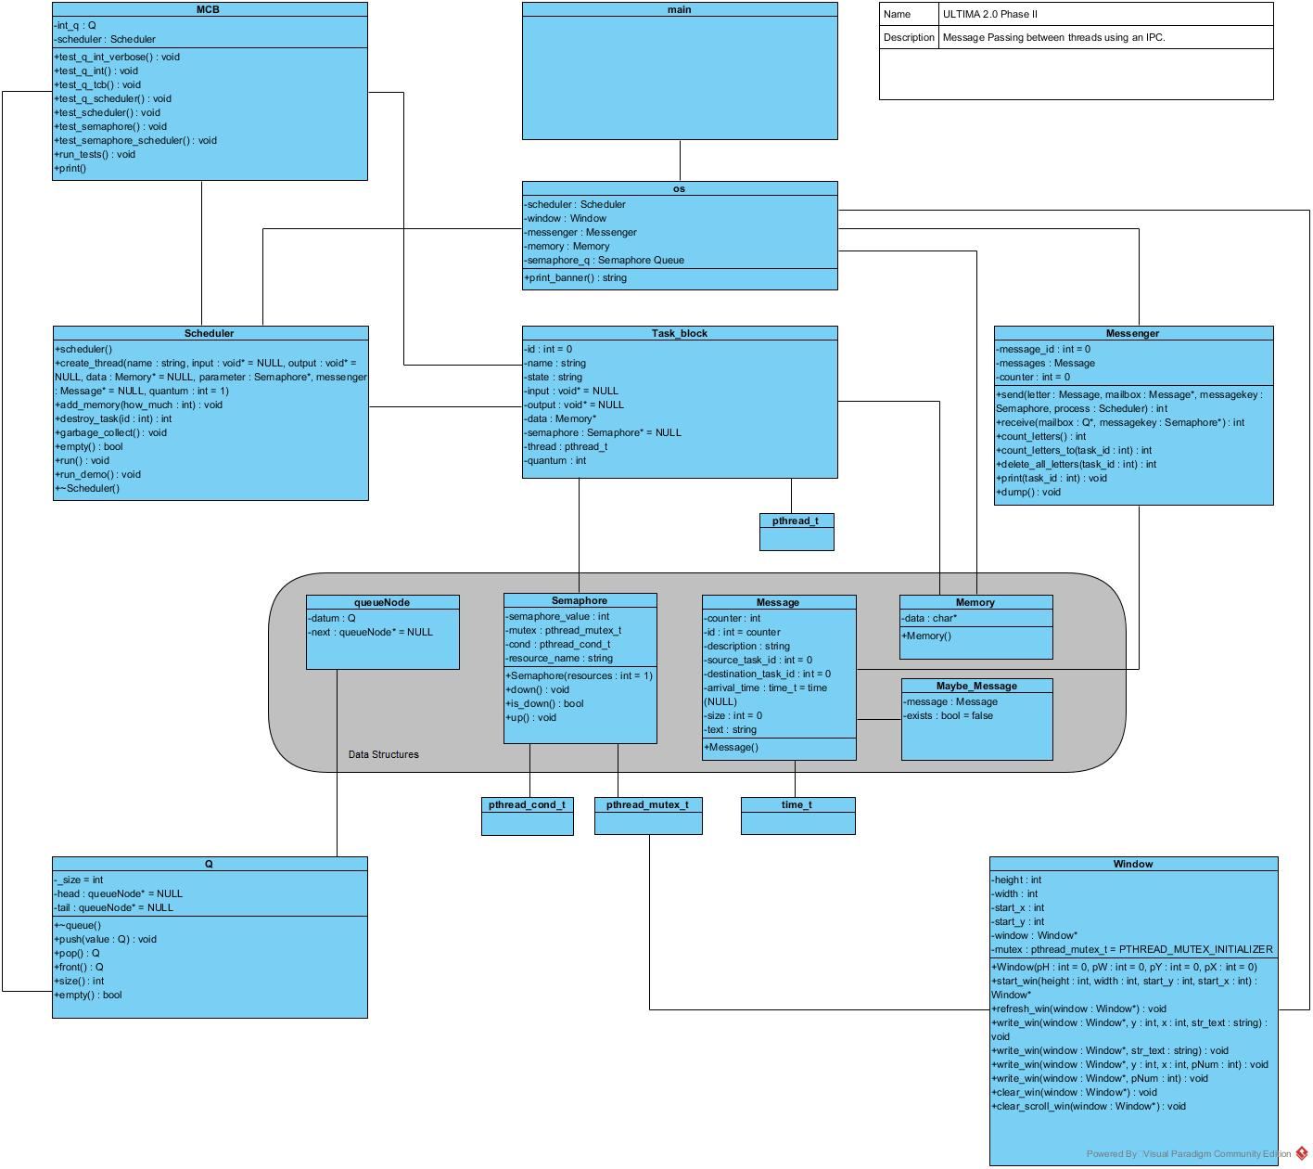
ULTIMA 2.0 Phase II Overview (With implementation of OS class, and an MCB)

Slide 21
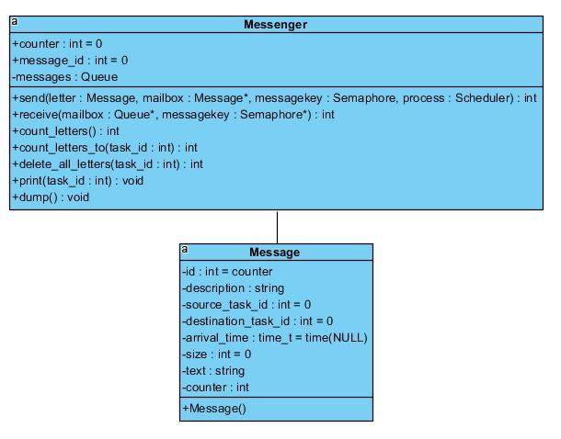
Message Passing
The Messenger class is responsible for interProcess communication (IPC). This class will create a queue of messages for each process.
The messenger can send, receive, and count messages for each thread, or count all of the messages in all of the queues.
send() and receive() both make use of a semaphore in order to stop race conditions.

Slide 22
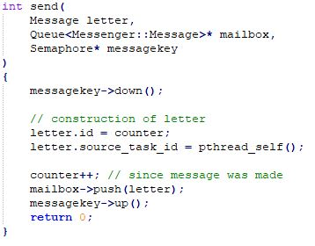
send()
send() loads a message onto the mailbox and sends it to another task associated with an id.
A mailbox is needed to hold the message. In order to send to a task to a mailbox the destination needs to exist. If a destination mailbox exists, send() will send the message to that location.
letter holds the actual message wanting to be sent to a task.

Slide 23
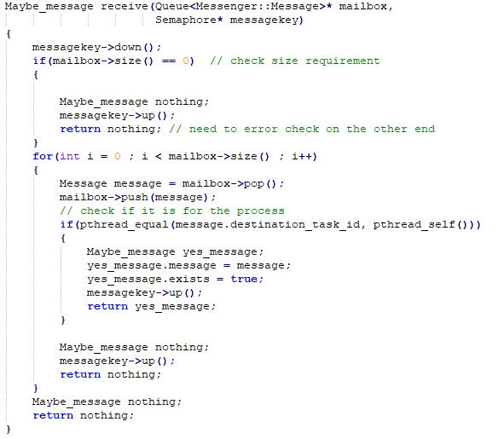
receive()
receive() lets the user know if the message it was trying to send to a task was successful or not.
Mailbox needs to check if the message made it, messagekey keeps the mailbox 'locked' to a specific task while it is down, while process checks if it is the correct location being sent to.

Slide 24
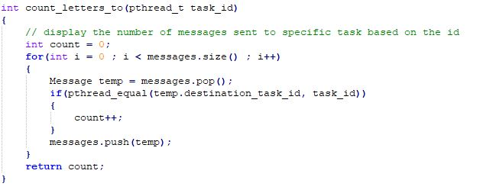
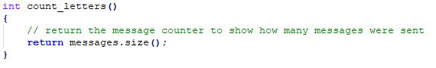
Counting All Letters
Counting Some Letters
count_letters()
count_letters_to()

Slide 25
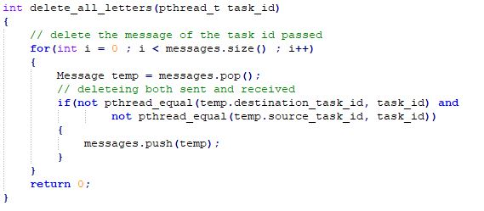
delete_all_letters()
delete_all_letters() deletes all of the messages sent to a certain task.

Slide 26
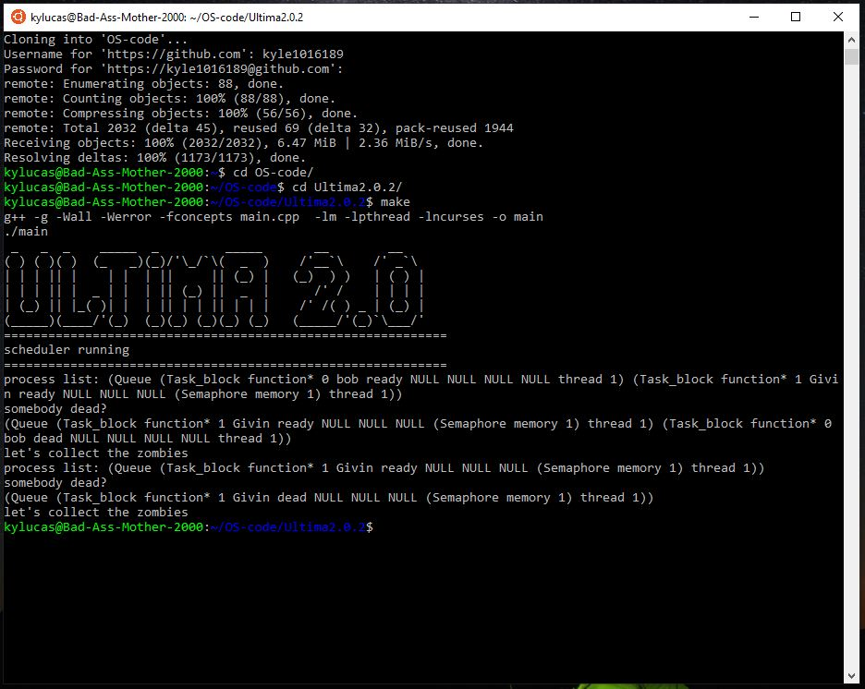
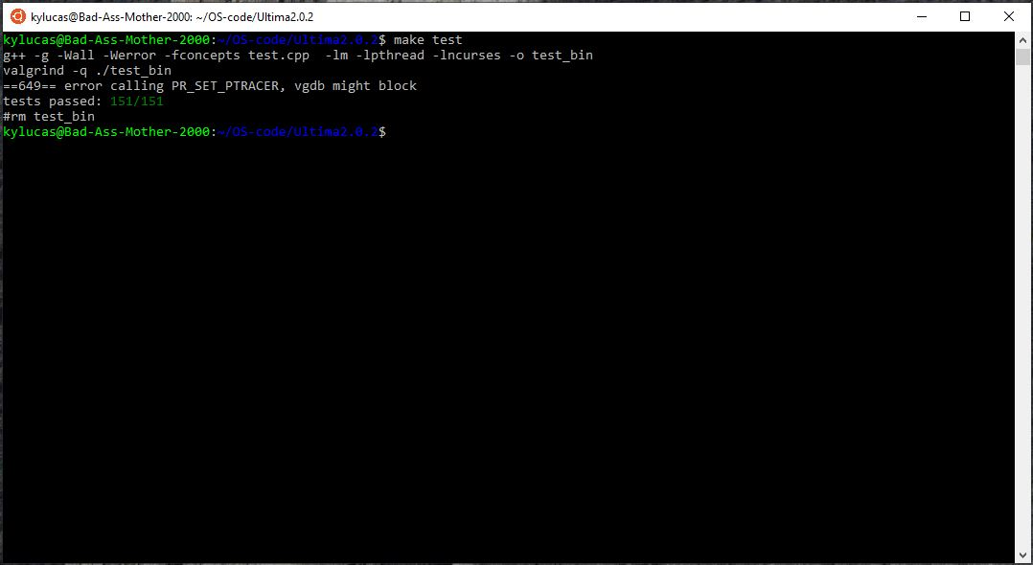
Phase II test

Slide 27
Phase III: Memory Management
Phase Goals
Assuming you have 1024 bytes of RAM available in your system, develop a class and series of functions which act as a memory manager.
The mem_mgr may be implemented as an:
independent thread (serving memory to its clients)
or it may be implemented as part of the main thread (“the OS”).
Your mem_mgr must provide at least two public functions for allocation and deallocation of memory. Mem_Alloc() and Mem_Free(). Several other functions will also be needed for internal debugging, dump, and clean-up operations.

Slide 28
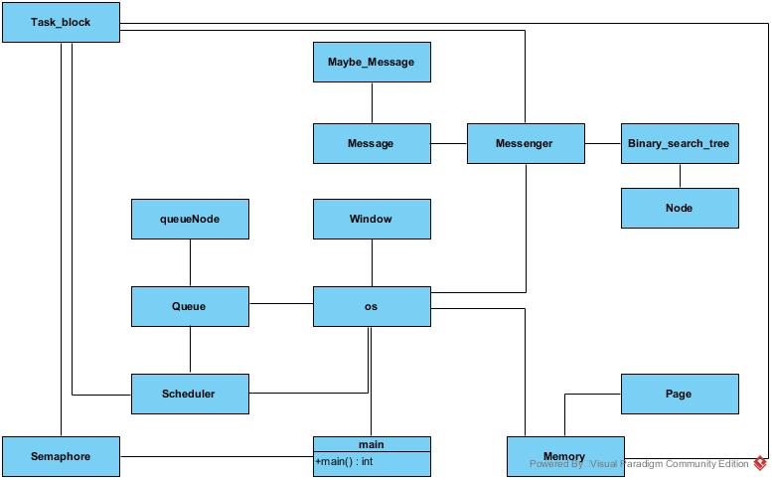
ULTIMA 2.0 Phase III Overview (With implementation of Memory & Page class)

Slide 29
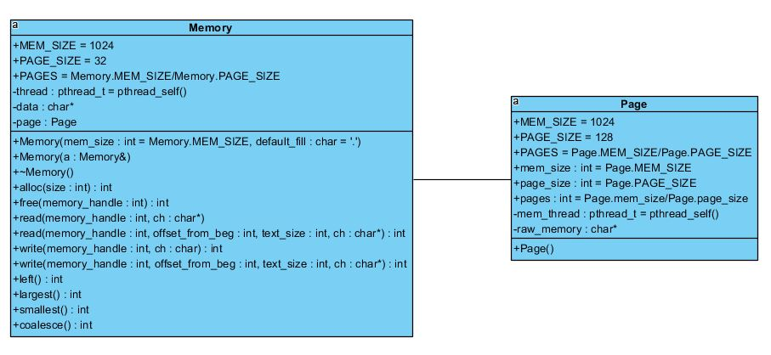
Memory Management
Together, the Memory and Page classes give the task control blocks memory for their functions or threads.

Slide 30
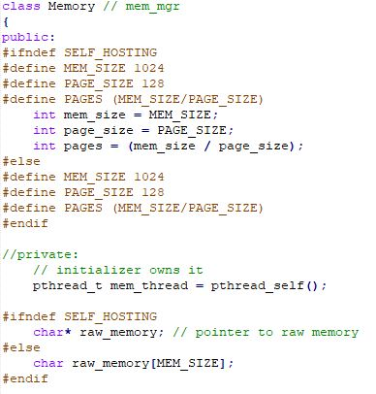
Definitions
The Memory class begins by making a certain amount of definitions. Most importantly, these two definitions are made:
Total Memory = 1024 bytes
Page Size = 128 bytes

Slide 31
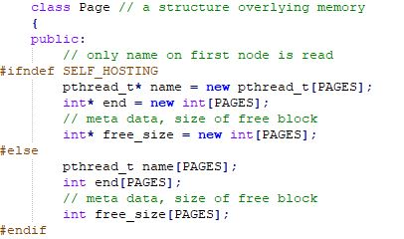
More definitions
The Page class begins by defining SELF_HOSTING which is needed as part of the Memory class.

Slide 32
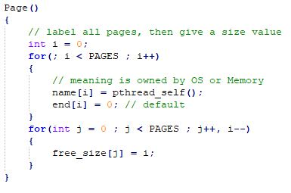
Page()
The Page class assigns pages to the Memory class so it can give that memory to tasks or functions.

Slide 33
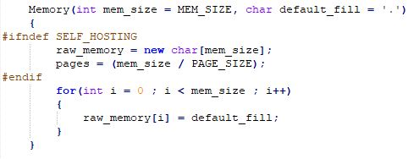
Memory()
Default constructor that makes memory the right size and blanks out the bits. Uses heap memory by request

Slide 34
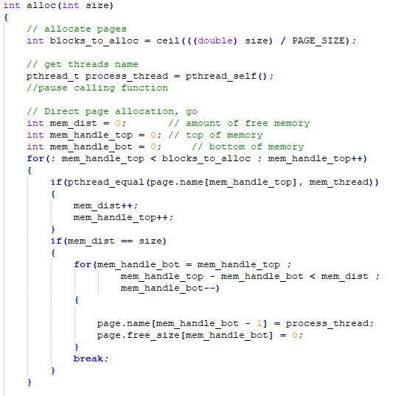
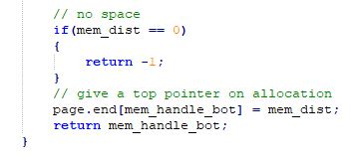
Memory Allocation
alloc() allocates the number of pages, or chunks of memory requested by the caller. size is determined by the passed 'size' variable.
If the size requested is available, the task will get that size of memory back.

Slide 35
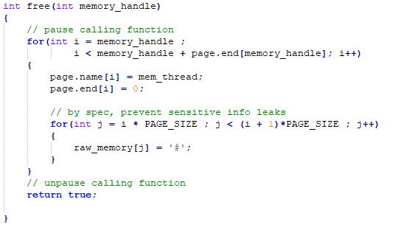
free()
Take a page pointer, memory_handle, to point to in use memory then deallocates that memory and frees it.
The block of memory your trying to free needs to already exist and be allocated.

Slide 36
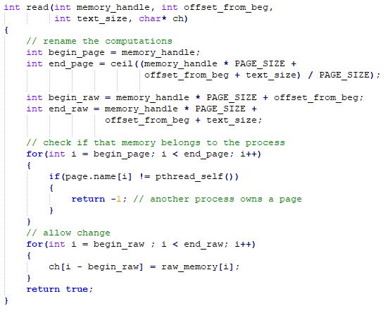
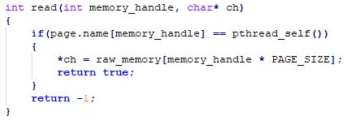
read()
read()
same as previous read()but will check ownership first. The memory was read and returned what it was
the memory was read or returned an error saying the delete failed.

Slide 37
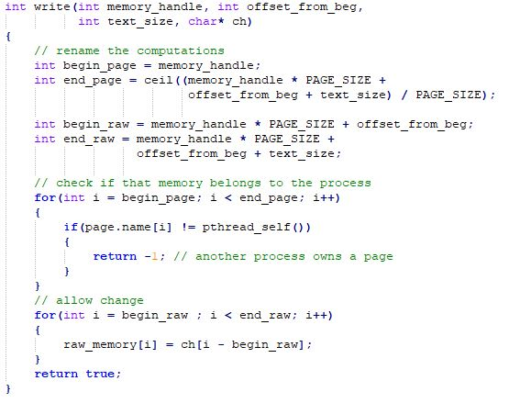
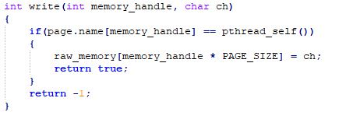
write()
write()
write to the memory when a task asks to write to memory. checks if the task owns that memory.
write to the memory when a task asks to save that information to memory.

Slide 38
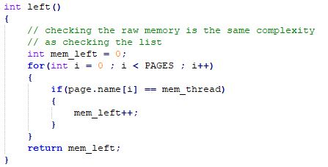
left()
Checks the number of pages and says how much memory is left.

Slide 39
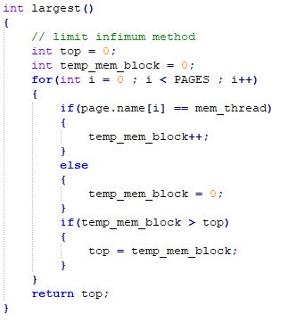
largest()
Determines how many pages are available which will determine the largest size of memory available.

Slide 40
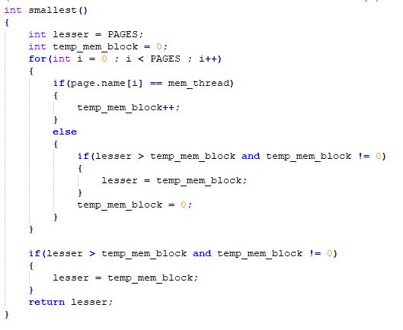
smallest()
Return the smallest block of memory that is available
Determines what the smallest block of memory that can be allocated is

Slide 41
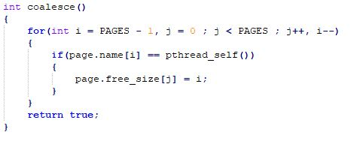
coalesce()
Combines meta data on free blocks of memory, but does not burp memory, given our page block model.
Memory blocks are now 'joined’.

Slide 42
coalesce()
Combines meta data on free blocks of memory, but does not burp memory, given our page block model.
Memory blocks are now 'joined’.

Slide 43
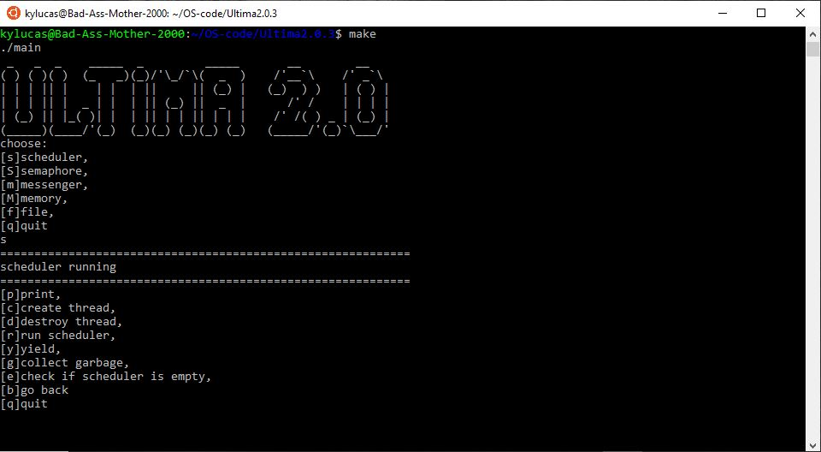
Phase III test

Slide 44
Phase IV: File System
Phase Goals
Create a new File System.
Assume you have a 2048 bytes of disk drive available.
Write a series of functions which allow the tasks to call upon the file system to open, read, write, close or check the directory of the file system.
The file system should accommodate:
Persistent files
and directories.

Slide 45
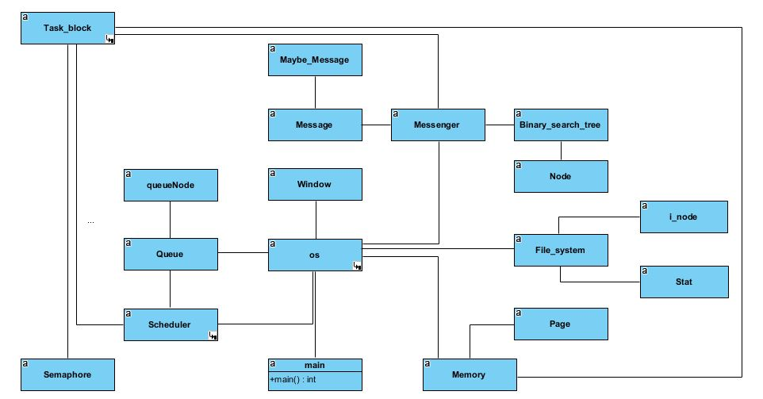
ULTIMA 2.0 Phase IV Overview (With implementation of File_system class)

Slide 46
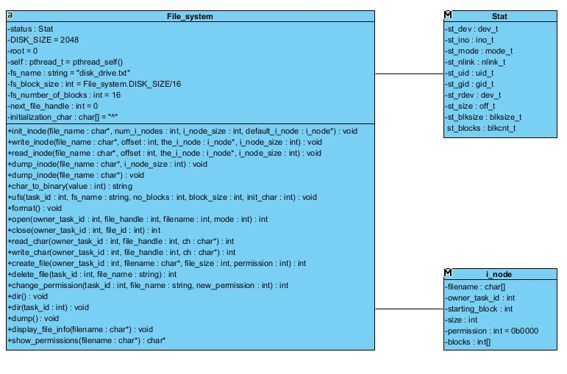
File System
The File_system class is responsible for handling the files in ULTIMA 2.0. It uses the struct Stat and an i_node system to keep track of the files and permissions, and which user is accessing the file. This should work with two different files, one of which is a 2K filesystem of 128 byte blocks and the other an I-node structure. Our file system has filesystem operations, file operations, and directory operations. Output of the filesystem will display a filehandle(file pointer), file name, blocks used, size, starting block, status, permissions of the file, and the owner ID.

Slide 47
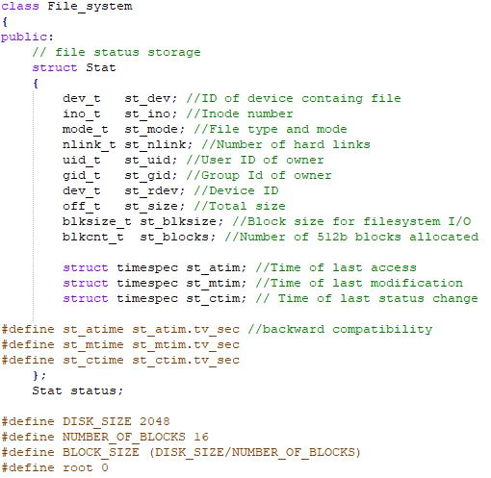
Definitions
The File_system class begins by defining a struct Stat, and also makes a certain amount of definitions. Most importantly, these two definitions are made:
Disk size = 2048 bytes
Number of blocks = 16

Slide 48
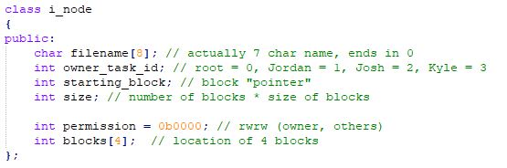
i_node()
Creates 'i_node' structures that serve as directory information.
There should be 16 i_node structures each of 40 bytes.

Slide 49
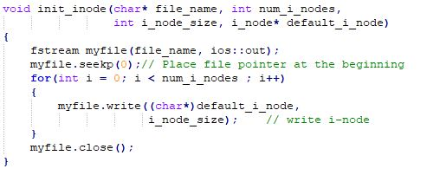
Initializing an i_node
Used to initialize an i-node and start a file for the filesystem.
If an i_node struct is available, an i_node will be initialized.

Slide 50
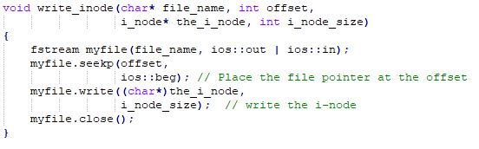
Writing an i_node
write_inode() opens a file for reading and writing so that characters can be written to the file.

Slide 51
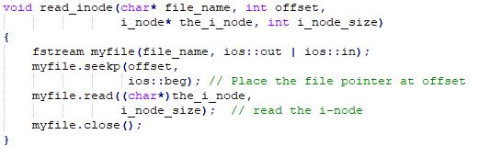
Reading from an i_node
read_inode() opens a file for reading and writing so that we can read what has been written to the file

Slide 52
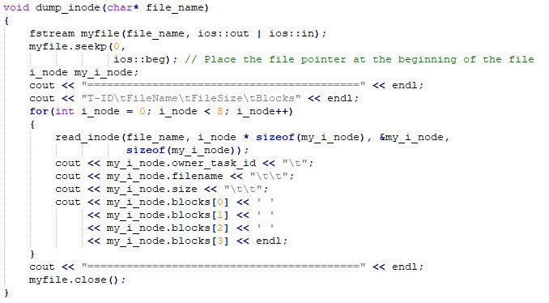
Dumping the i_node
This function dumps all the contents of the file on the screen for the user to see the i-node information.

Slide 53
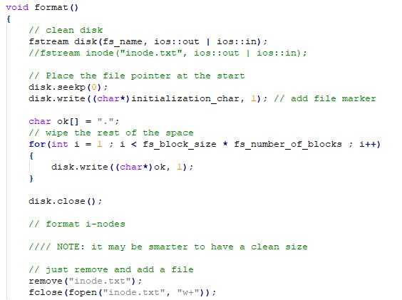
format()
format() formats the current file system similar to windows.

Slide 54

Opening a file
Open a file if it belongs to the owner and file handle is a valid handle.

Slide 55

Closing a file
Close the file and return -1 if there is an error.

Slide 56

Reading a character
Write a character to a file and return -1 if an error occurs while keeping track of current file location.

Slide 57
format()
format() formats the current file system similar to windows.

Slide 58


Creating files
Creates the file used for the whole filesystem class.

Slide 59

Program Execution
The OS class is responsible for managing aspects of the operating system which keep it running properly. The OS class creates a queue to hold the semaphores, and starts the Scheduler, Window, Messenger, Memory, and File_system classes. In addition to this, the OS class begins the program by asking the user to log into the program and presents the user with a UI.
The program executes when main() is called. Main() starts the OS class which creates a queue to hold the semaphores, and starts the Scheduler, Window, Messenger, Memory, and File_system classes. In addition to this, the OS class begins the program by asking the user to log into the program and presents the user with a UI.

Slide 60

Logging in to ULTIMA 2.0
TESTING

Slide 61


Logging in to ULTIMA 2.0
Screenshots from the ULTIMA 2.0 operating system will illustrate the use of the system. The system is portable across a few different architectures and was built using the Valgrind debugging tool. Memory leaks are trapped and easier to debug using this suite.
More tests follow;
Currently working on getting typed text to appear with the new windowing feature added.
Below is the user.txt file which keeps track of users login.

Slide 62

Testing of the File System

Slide 63
Fixes to come
As seen from the previous screen shots, the screen does not display character input even though the screen is taking input.
Functions listed do work, for the most part, but still working on displaying to the screen.

